Slide 1
YPFF College and Occupation Search

Slide 3
Notes:
You can use the Interactive Interview where they ask you a bunch of questions, or use the tabs at the top (which is what we are going to do) to search for a school

Slide 7
Notes:
There are 2,078 colleges in the US with education as a major

Slide 8
Choose a school to answer the questions about

Slide 9
You will find all the information needed on this page using these top tabs
And, if you really like the college and want to save this info, click on Add to my College List

Slide 11
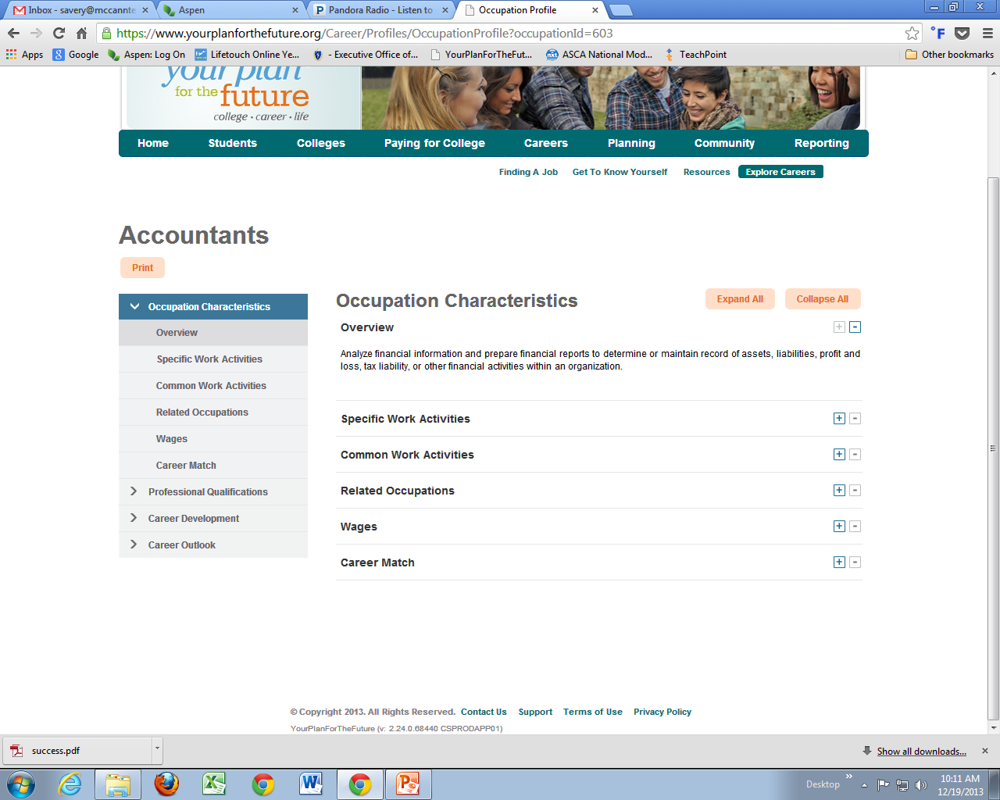

Slide 12
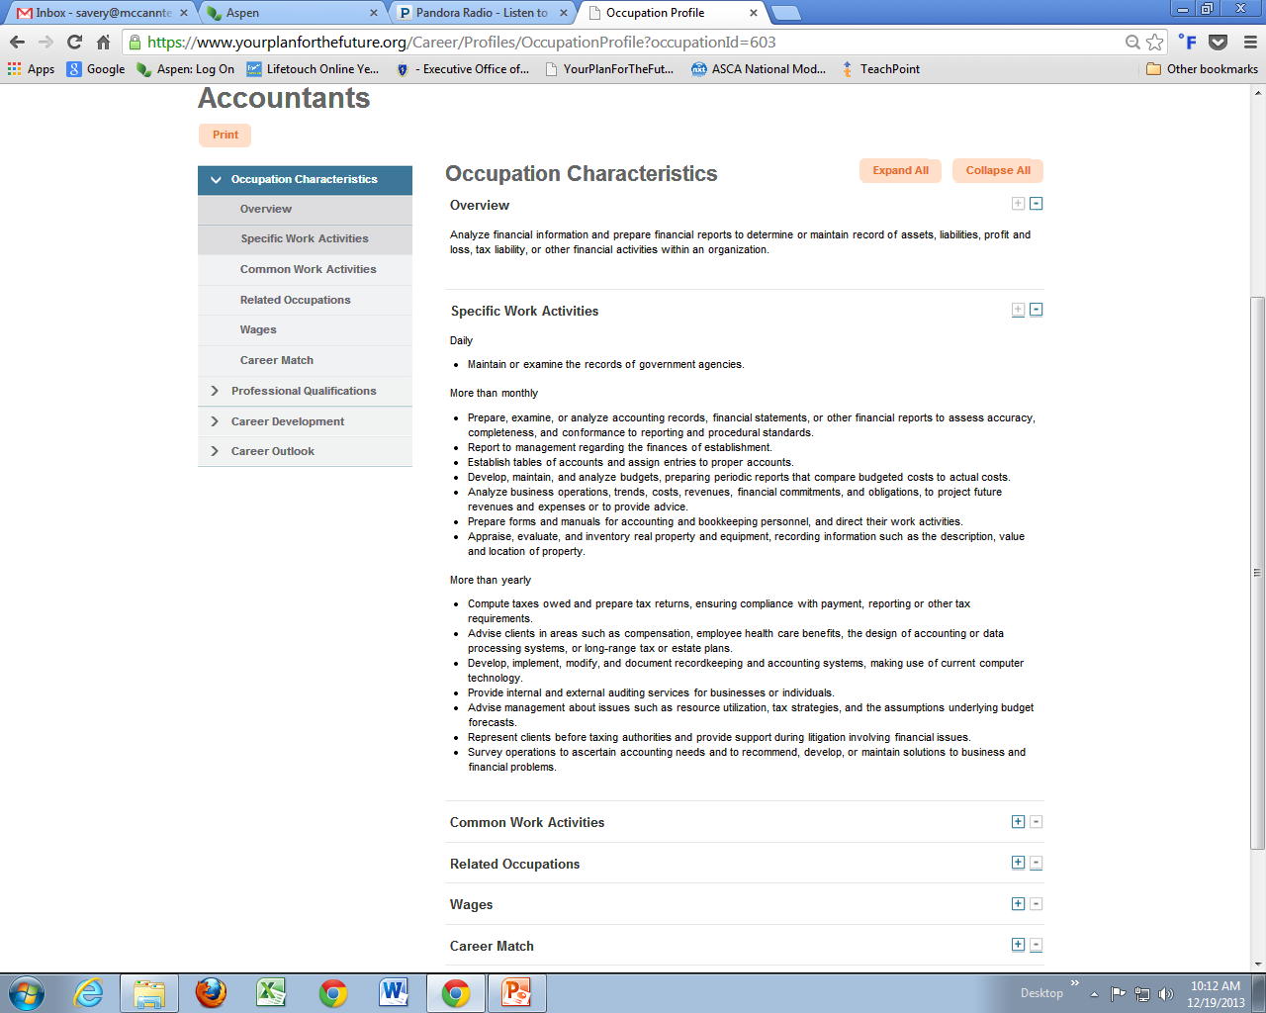

Slide 13
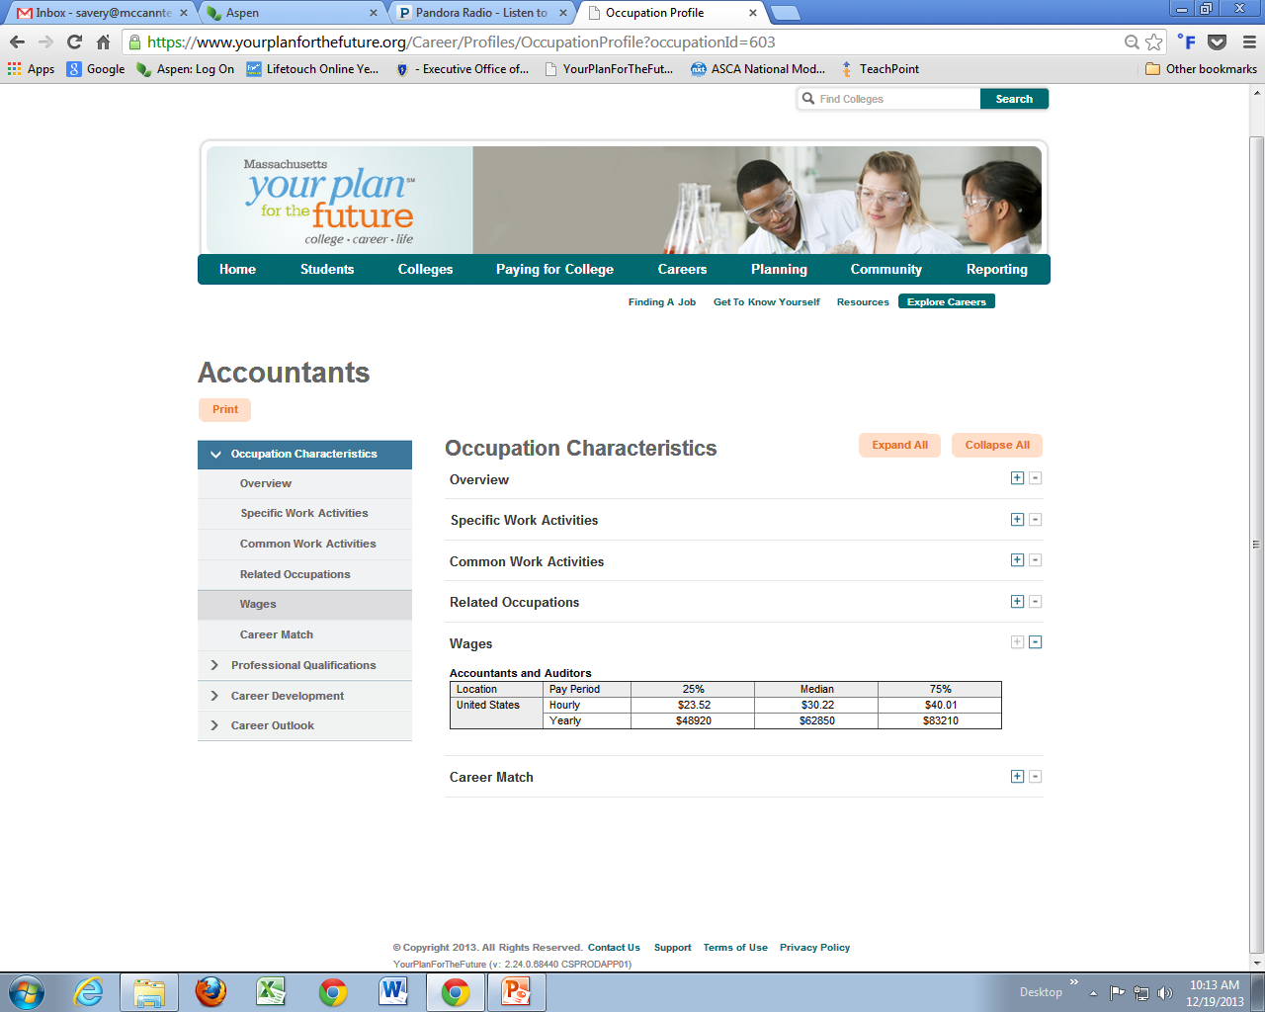
Wages and Related Occupations found here

