Slide 1
TFHS Class of 2018 9th Grade Seminar October 2014
Guidance Counseling Department
Beth Fortin – Last names A-L
Maria Paoletti – Last names M-Z
Karen Hidalgo – Graduation Coach
Sharon Girard – Administrative Assistant
Your counselor is available to support you
in the following areas:
Academic Planning and Course Selection
College and Career Planning/Preparation
Social/Emotional Support and Intervention

Slide 2
TFHS Graduation requirements
Mathematics | 4 units
English (AP classes count as 1 unit) | 4 units
Science | 3 units
History/Social Science | 3 units
Art | 1 unit
Technology | 1 unit
Physical Education | 4 units
Health | 1 unit
Pass all required courses
Proficiency on the MCAS in Biology, ELA and Math
Minimum 155 Credits

Slide 3
TFHS Promotion requirements
At a minimum, students must have earned:
35 credits be promoted to 10th grade
75 credits to be promoted to 11th grade
110 credits be promoted to 12 grade
Grading: Highest possible grade 100
Below 60 - Failing

Slide 4
Transcript
A record of High School courses taken and credits awarded
GPA (grade point average)
Class Rank
Course grades

Slide 5
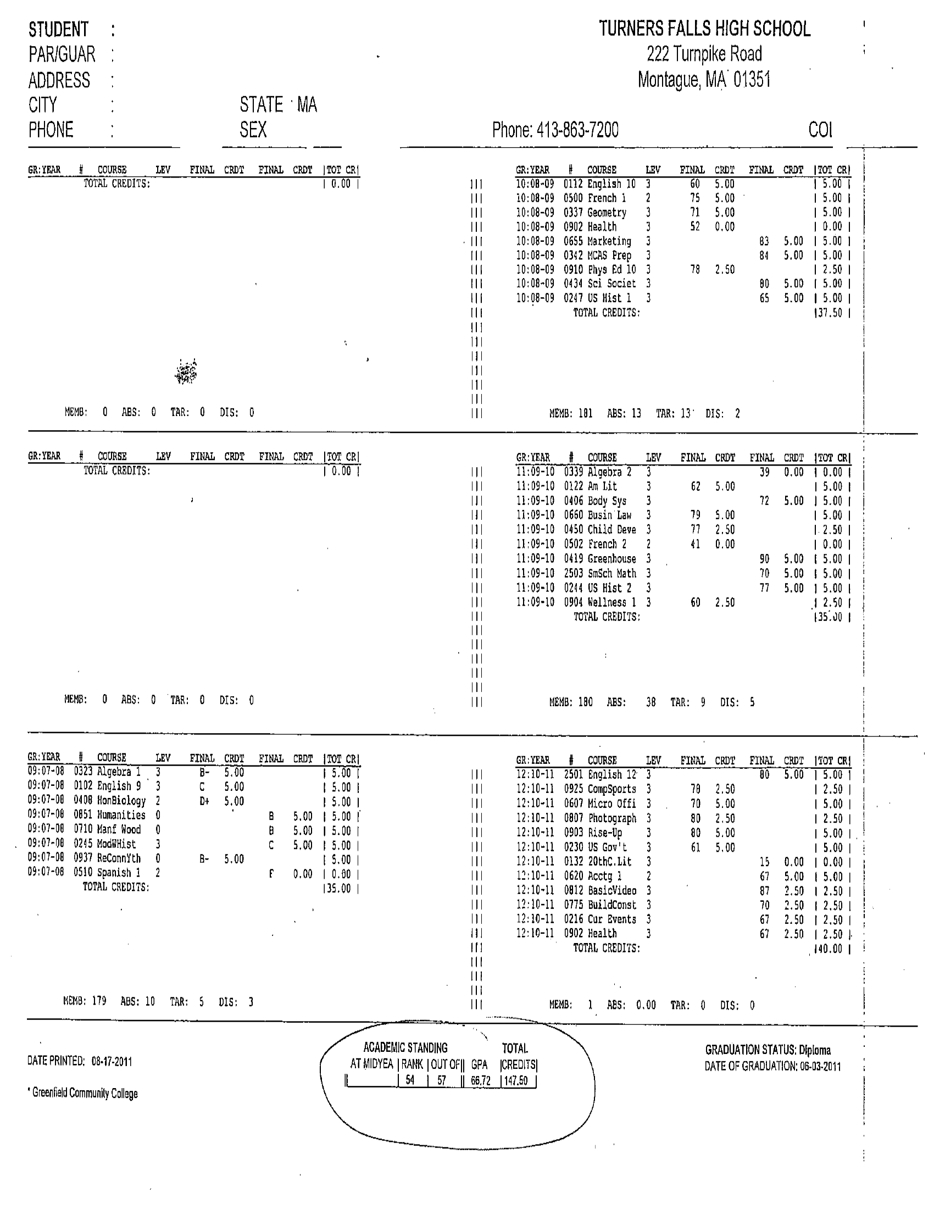

Slide 6
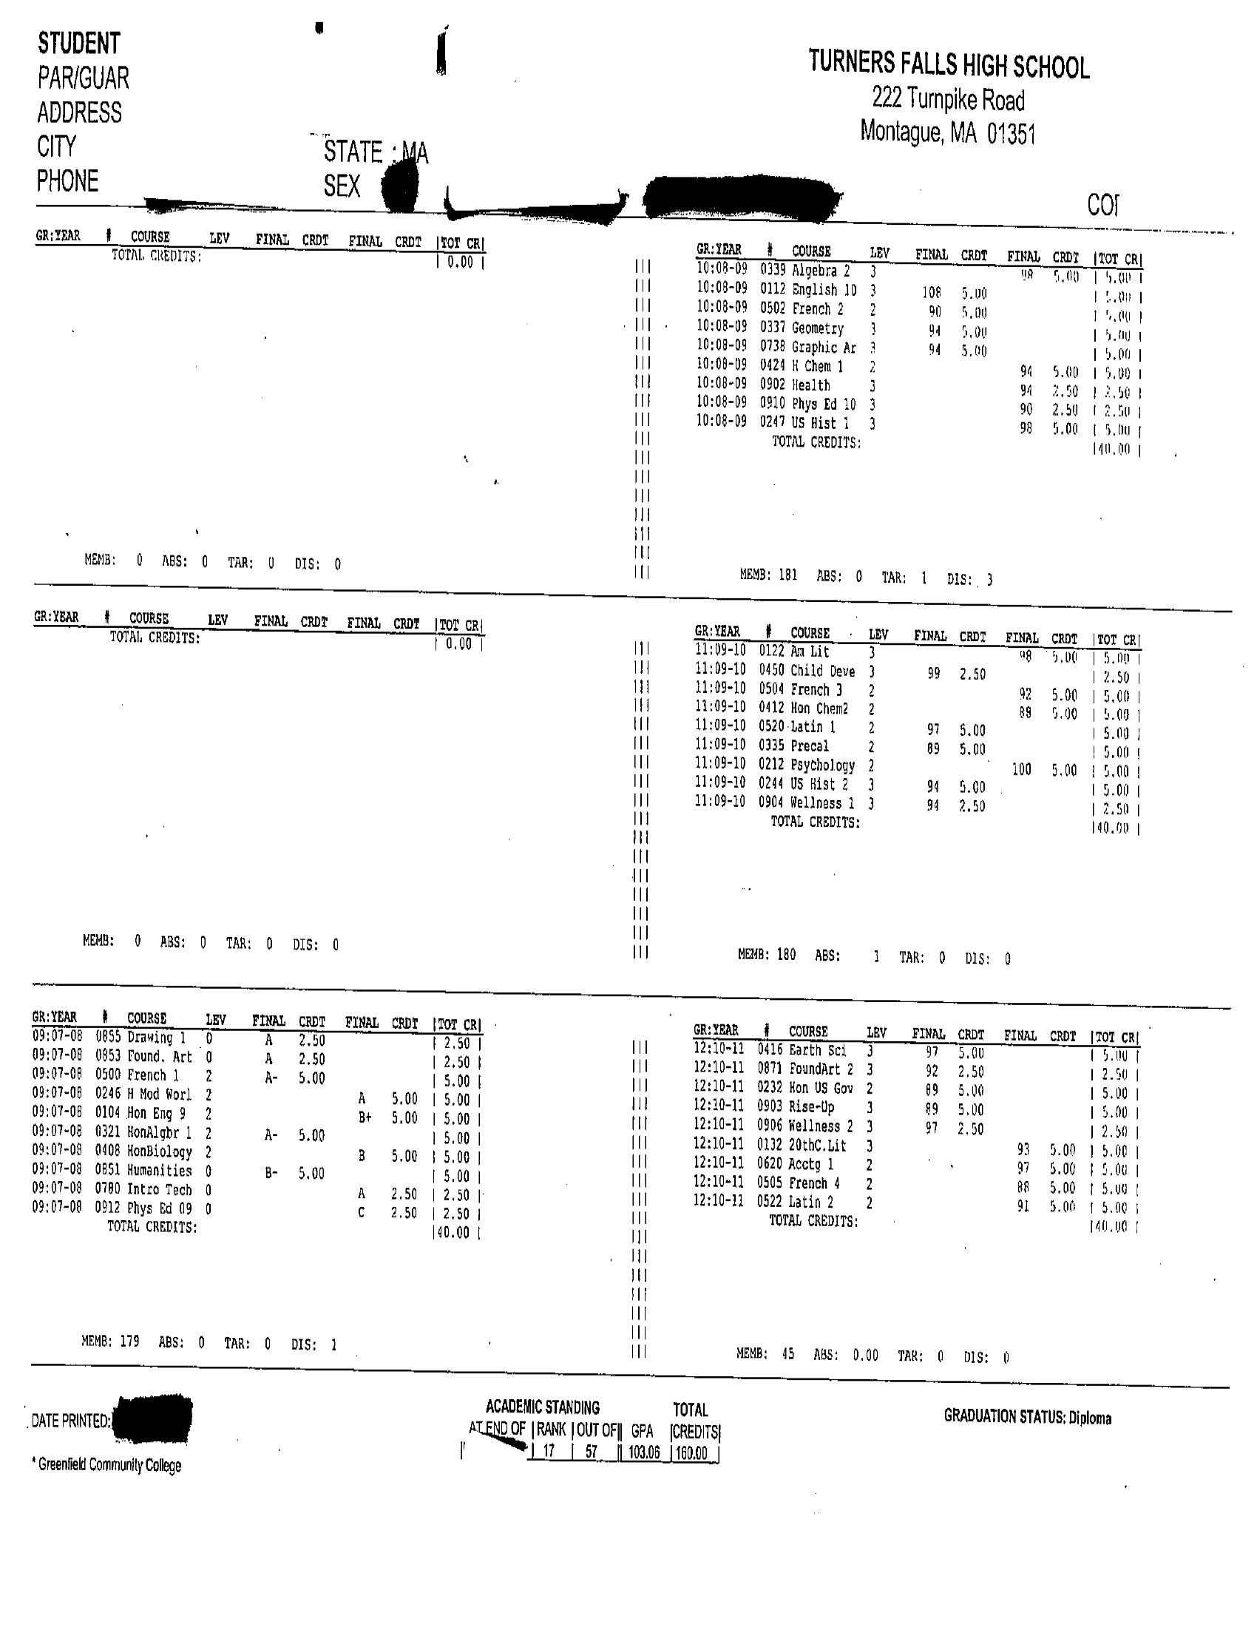

Slide 8
Curriculum Levels & Grading
4 levels:
Level 1: ADVANCED PLACEMENT COURSES – Carry the greatest weight when determining GPA and with college admissions-potential to earn college credit
Level 2: HONORS COURSES & Foreign Languages– Next greatest weight-more academically intense than level 3-
Level 3 – Regular academic courses
Level 0 – Internships, GAP, School to Work (un-weighted classes that are not included in GPA)

Slide 9
Grade Point Average (GPA)
Colleges look at freshman grades.
GPA plays a significant part in class ranking which is started in 9th grade.
Weighted grades impact class rankings.

Slide 10
Things to consider when planning your future …
Interests - what do you enjoy doing?
Ability – your unique capabilities and talents
Achievement - grades and scores you have earned
Motivation - workload you are able and willing to take
Focus and build on your strengths

Slide 11
Creating A “4- Year Plan”
Is a sequence of courses taken during high school and needed for graduation.
Will help you to stay on track for graduation.
The plan will help you reach your high school and post high school goals.
There is no universal plan. It should be unique to you and your goals.
Let’s take a look at one…

Slide 12
Turners Falls High School Four Year Plan
Name:___Example Student___________________________________ Date: ____Dec. 13, 2012_________________
 | 9th grade | 10th grade | 11th grade | 12th grade | Notes
 | 9th grade | 10th grade | 11th grade | 12th grade | Notes
English | English 9 Language Arts Lab Honors English 9 | English 10 Honors English 10 | American Lit. 20th Century Lit. AP Lang. & Comp. | 20th Century Lit. American Lit. AP Lit. and Comp. AP Lang. & Comp. | *4 years needed*
Math | Algebra I Algebra I Honors Algebra IA & IB | Geometry Honors Geometry Algebra II Honors | Algebra II Honors Algebra II Precalculus | AP Calculus | *4 years needed* Other courses: Math in Life Precalculus AP Calculus Accounting Statistics
Science | Science Science Honors | Biology Honors Biology | Chemistry | Greenhouse | *3 years needed * Body Systems Greenhouse Science in Society Physics Earth Science Chemistry 1 Honors Chemistry 1 Honors Chemistry 2 AP Biology Environmental Sci. Human Phys and Anat.
History | Modern World Hist. Honors World Hist. | US History I Honors US History I | US History II Honors US History II AP US History | AP US History | *3 required courses needed*
Health | Health |  |  |  | *One course needed*
PE | PE | PE | PE | PE | *4 years needed*
Art and Technology | Foundations of Art, Microsoft Office | Basic Video | Graphic Arts | Ceramics II | *One art course and one technology course required*
Foreign Language |  | Spanish I | Spanish II | Spanish III | 2-3 courses recommended for students interested in most 4 year colleges
Other/ Electives | Ceramics Band A & B | Theatre Arts | Child Development
GAP | GAP | GAP | GAP | GAP | All students are automatically assigned every year
Total credits (140 required) | 45 | 45 | 45 | 45

Slide 13
9th Grade Matters
Classes taken in 9th grade count toward graduation and college entrance.
Failing multiple classes may cause you to fall behind for graduating with your class- different from middle school.
Please talk to your counselor if you have
questions or concerns about graduation
requirements.
If you get an “F” in a class that is
required for graduation,
you must make it up.

Slide 14
Get Help when you need it…
Guidance and Adjustment Counselors
Peer Tutoring – ask your School Guidance Counselor
Meet with teachers for extra help
Study during GAP
Stay after for extra help
Let your parents know
Edline – for students & parents

Slide 15
How to be Successful…
Attendance is extremely important to your success in high school.
Take your classes seriously and keep your grades up!
Challenge yourself with Honors & AP Classes.
Go to class prepared.
Develop good study habits/study daily.
Ask questions/get help.
Questions/concerns…make an appointment with your counselor.
Participate in clubs, sports, organizations & community service.

Slide 16
Questions
☺

